Slide 1


3 December, 2022
Sponsored and Supported by:

Slide 2


SPEAKERS PANEL
Session 5
Turbo-boost your SPFx upgrades and deployment using CLI for Microsoft 365
2.50 PM – 3.35 PM
Arjun Menon
Solution Architect | Microsoft MVP

Slide 3








A Big Thank You to all the Sponsors!
Diamond:
Learning Partner:
Platinum:
Gold:

Slide 4


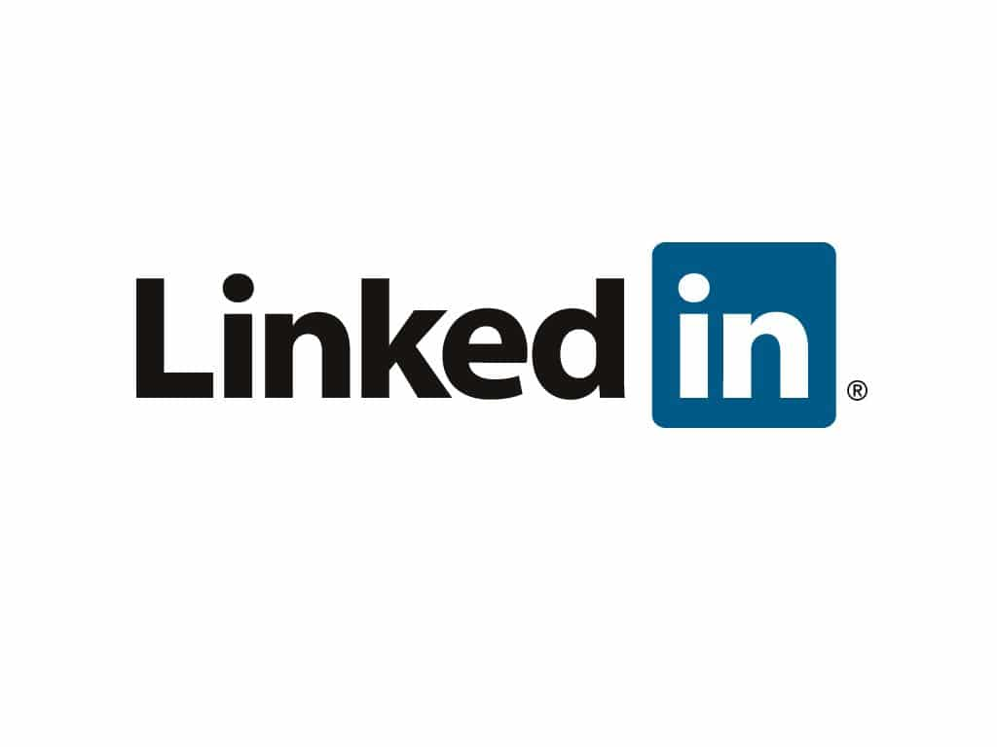



WHO AM I
Arjun Menon
Solution Architect with TCS
Microsoft MVP (M365 Development)
Maintainer – CLI for Microsoft 365
Core Team Member – Microsoft 365 Patterns & Practices (PnP)
/in/
arjunumenon
arjunumenon.com
This Photo by Unknown Author is licensed under CC BY
This Photo by Unknown Author is licensed under CC BY

Slide 5
Agenda
What is CLI for Microsoft 365 and its features
Why CLI for Microsoft 365 is relevant to SharePoint Framework (SPFx)
Demo through a Use Case

Slide 6
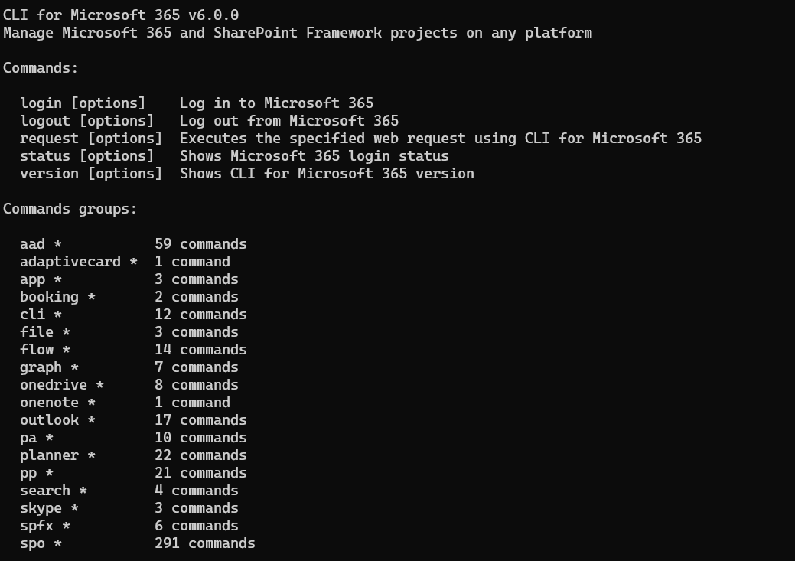
CLI for
Microsoft 365
Cross-platform way of managing Microsoft 365 workloads
Accessible from almost any toolchain which is being used for Microsoft 365 development
Secured and following the Microsoft 365 security practices

Slide 7

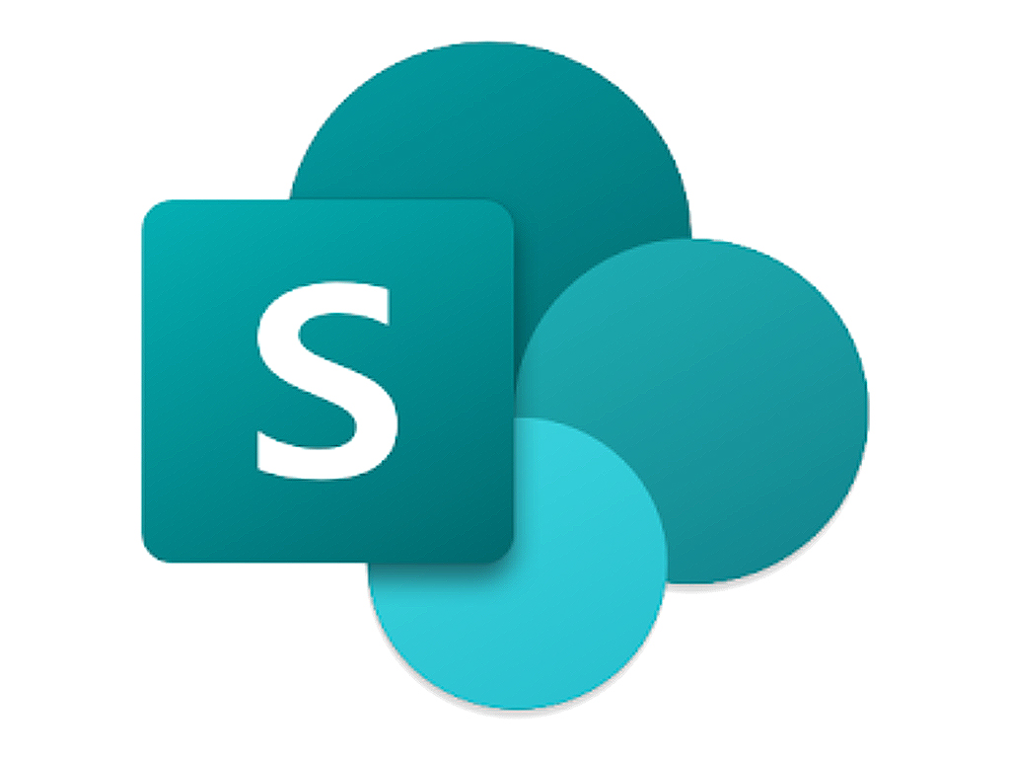


Supports almost all the Microsoft 365 Workloads
Manage SharePoint site provisioning
Managing Microsoft Teams
Power Platform Management
Managing Azure Active Directory

Slide 8






Where will I execute it from?
Any Operating System
Any Shell
Windows
MacOS
Linux
PowerShell
Bash
Command
etc.

Slide 9
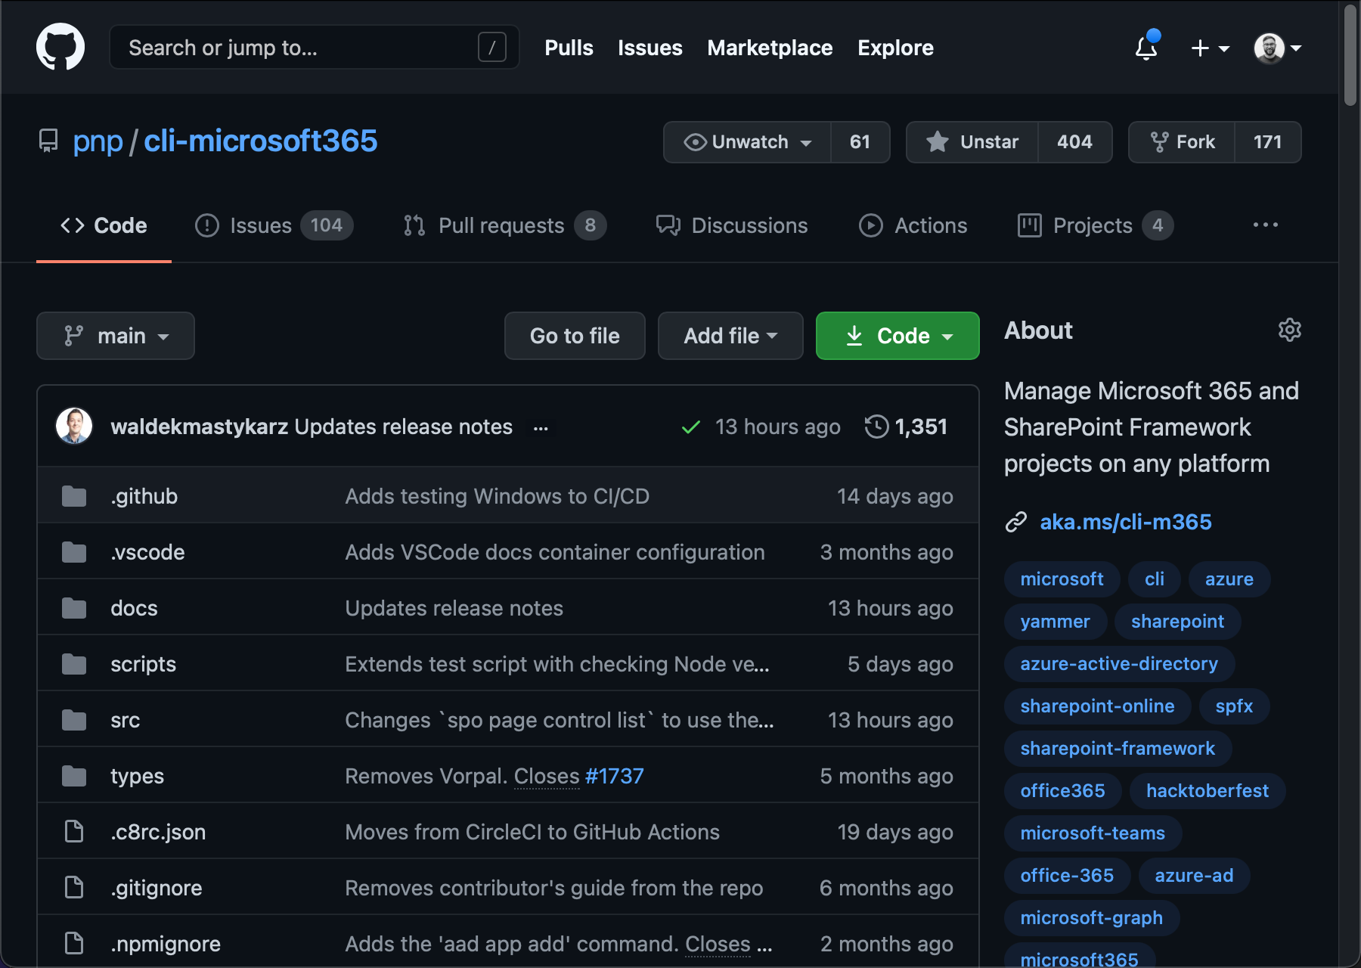



How is it built and who built it?
Built by the community for the community
Built on Modern Tooling
Node JS
TypeScript
Azure Active Directory
Notes:
Built on Toolchain similar to SPFx. NodeJS, TypeScript etc.

Slide 10



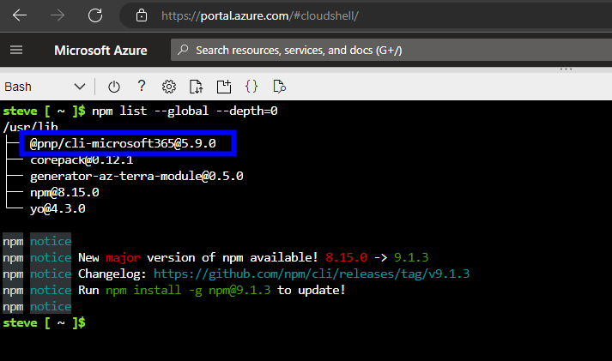
How will I get started
npm install -g @pnp/cli-microsoft365
Any Package Manager
NPM
YARN
Docker Container
Supports execution from a docker container
CLI for Microsoft 365 is baked with Azure Cloud shell
You don’t even need to install CLI in Azure Cloud Shell. It is baked within the shell
Notes:
You can even run CLI for Microsoft 365 Azure container. If you want to schedule a scripted job, you can easily tie it up with a Logic App and Container behind the scenes

Slide 11

What is with SPFx and CLI for Microsoft 365
LIKE VEERU & JAI ?
Both are built on similar toolchain
Seamlessly co-exist
SPFx Deployment is super easy!!
Notes:
Build on the similar toolchain. Due to that it could be easily connected to bring in expected outcomes
Could be in terms of Validating the project, Deploying the packages
Even configure CI / CD easily

Slide 12




Ready to turbo-boost SPFx development & deployment experience
M365 SPFX DOCTOR
M365 SPFX PROJECT UPGRADE
Easy CI/CD Setup
Verifies your DEV Environment
M365 SPFX PROJECT DOCTOR
Help to upgrade your older SPFx projects to a later version easily by giving report and steps to upgrade
Build CI /CD Pipelines in Azure DevOps and GitHub
Gives the report of your SPFx Project folder
Notes:
SPFX Doctoror
For Validation of the your development environment
For validating your SPFx Project structure
Project Upgrade
Upgrade SPFx built on older versions easily
CI / CD
GitHub actions for SPFx deployment
NPM based commands for Azure DevOps

Slide 13
Let us see it in action
Use Case
Want to deploy a Webpart which shows the M365 Groups (Using PnP Webpart)
Need to validate the project
Implement CI/CD for the same
Bonus Action : Rename the SPFx Project easily
Code Repo : https://github.com/arjunumenon/M365SatBLR-2022

Slide 14
THANK YOU

Slide 15

SPEAKERS PANEL
Next Session
Extend Microsoft Viva Connections with SPFx
3.50 PM – 4:35 PM
Kirti Prajapati
Modern Workplace Consultant | Office Development MVP |

Slide 16

SPEAKERS PANEL
Session 1
Welcome Note
09:00 AM – 09:15 AM IST
Deepak Rajendran
Driving Advocacy Programs
Microsoft

Slide 17

SPEAKERS PANEL
Session No.
Session name
Session Time
Speaker 1
Speaker 2
Designation
Designation

Slide 18
SPEAKERS PANEL
Session No.
Session name
Session Time
Speaker Name
Designation

Slide 19
SPEAKERS PANEL
Next Session
Session Name
Session Time
Speaker Name
Designation

Slide 20

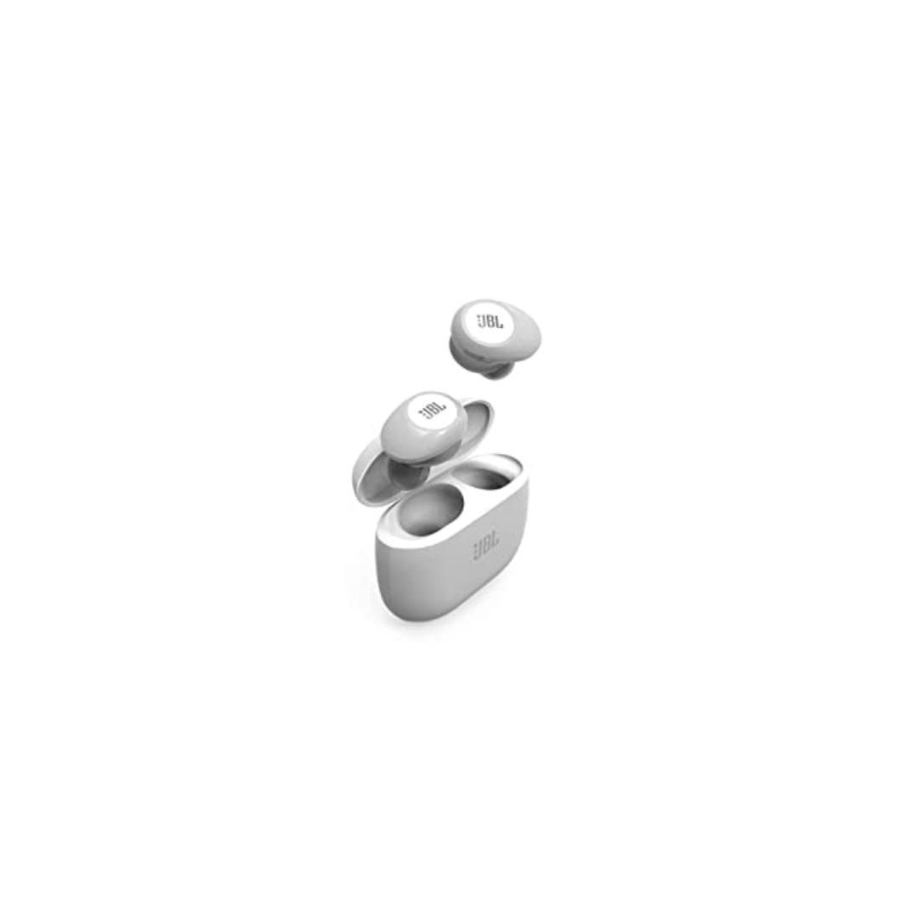
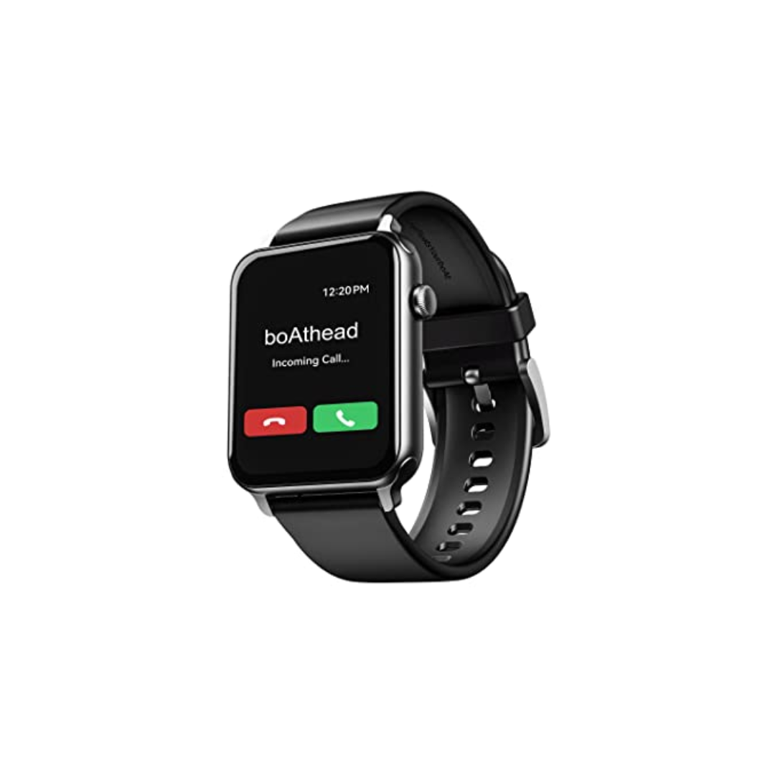

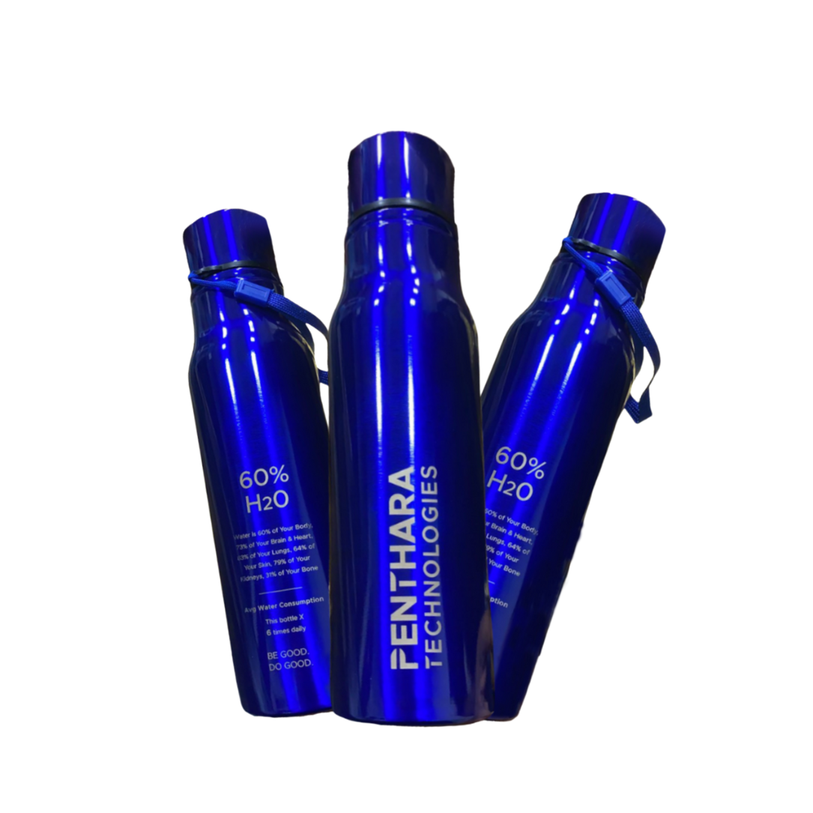
A One Day In Person Event
Win exiting prizes!
Lenovo M10 FHD Plus (2nd Gen)
JBL Tune 125TWS
boAt Blaze Smart Watch
Hands on sessions by experts and community leaders
Deep-dive into Microsoft 365 Services
Focus on:
Microsoft Teams
Power Platform
SharePoint
Cool Water Bottle
Developer Road Ahead

Slide 21




SUPPORT A CAUSE
“Giving is Receiving”
Support ‘Scope for Change’ to create more impact and touch the lives of more underprivileged students.

